Slide 1
Increasing public participation in user research
Digital.gov presentation - February 7, 2023

Slide 2
What we’ll cover today
10x and the idea we’re working on
What we learned:
Common barriers to conducting research with the public
What 10x discovered about creative incentives, including paid compensation
How incentives support agencies' diversity, equity, and inclusion goals
Possible risks of public participation in user research
Successful approaches to compensation by teams at GSA/TTS
Our project’s next phase of work
How to get contribute and stay involved
Discussion with questions and answers

Slide 3
What is 10x?
At 10x, we crowdsource ideas from federal employees and turn them into real products that improve the public’s experience with the federal government.
We believe that the most creative, game-changing ideas come from those who work most closely to the problem — civil servants like you. We invite any federal employee to submit an idea for how to use technology to improve public service.
We turn good-for-government ideas into good-for-people solutions

Slide 4
Our beliefs drive our unique model – project sourcing
Project Sourcing
Funding
Risk Mitigation
Unknown Outcomes
We solicit technology ideas from federal employees within the U.S. Government.
We believe that civil servants are closest to the problems and a source of great ideas.
Most ideas for new technology projects are not going to work out.
We believe it’s better to spend $20,000 on something that won’t work out than $20,000,000.
Our incremental approach enables us to perform due diligence on our investments.
We believe in an evidence-based approach to product development.
We do not know where a project is going to end up during our earlier phases.
And we believe that’s a good thing.

Slide 5
Our beliefs drive our unique model - funding
Project Sourcing
Funding
Risk Mitigation
Unknown Outcomes
We solicit technology ideas from federal employees within the U.S. Government.
We believe that civil servants are closest to the problems and a source of great ideas.
Most ideas for new technology projects are not going to work out.
We believe it’s better to spend $20,000 on something that won’t work out than $20,000,000.
Our incremental approach enables us to perform due diligence on our investments.
We believe in an evidence-based approach to product development.
We do not know where a project is going to end up during our earlier phases.
And we believe that’s a good thing.

Slide 6
Our beliefs drive our unique model – risk mitigation
Project Sourcing
Funding
Risk Mitigation
Unknown Outcomes
We solicit technology ideas from federal employees within the U.S. Government.
We believe that civil servants are closest to the problems and a source of great ideas.
Most ideas for new technology projects are not going to work out.
We believe it’s better to spend $20,000 on something that won’t work out than $20,000,000.
Our incremental approach enables us to perform due diligence on our investments.
We believe in an evidence-based approach to product development.
We do not know where a project is going to end up during our earlier phases.
And we believe that’s a good thing.

Slide 7
Our beliefs drive our unique model – unkown outcomes
Project Sourcing
Funding
Risk Mitigation
Unknown Outcomes
We solicit technology ideas from federal employees within the U.S. Government.
We believe that civil servants are closest to the problems and a source of great ideas.
Most ideas for new technology projects are not going to work out.
We believe it’s better to spend $20,000 on something that won’t work out than $20,000,000.
Our incremental approach enables us to perform due diligence on our investments.
We believe in an evidence-based approach to product development.
We do not know where a project is going to end up during our earlier phases.
And we believe that’s a good thing.

Slide 8

10x Phases
Every phase requires more evidence in order to proceed.
Phase 1
Phase 2
Phase 3
Phase 4
Investigate
Discover
Develop
Scale
2-3 weeks
Understand the problem space
8-10 weeks
Understand the solution space
A few months
Build the solution
A lot of months
Scale the solution

Slide 9

The Original Idea
How might we incentivize public participation in research?
“
As federal agencies strive to improve customer experience, they need the ability to conduct research and usability testing with members of the public. But there are currently very few incentives or tools available to promote participation in research and testing. 10x will investigate ways to incentivize public participation in research, which is critical to designing effective products…

Slide 10

Executive Order - Customer Experience
“
Our Government must recommit to being “of the people, by the people, [and] for the people” in order to solve the complex 21st century challenges our Nation faces. Government must be held accountable for designing and delivering services with a focus on the actual experience of the people whom it is meant to serve…Strengthening the democratic process requires providing direct lines of feedback and mechanisms for engaging the American people in the design and improvement of Federal Government programs, processes, and services.
Executive Order 14058 of December 13, 2021 - Transforming Federal Customer Experience and Service Delivery To Rebuild Trust in Government

Slide 11
Human-Centered Design
The term “human-centered design” means an interdisciplinary methodology of putting people, including those who will use or be impacted by what one creates, at the center of any process to solve challenging problems.
Executive Order 14058 of December 13, 2021 - Transforming Federal Customer Experience and Service Delivery To Rebuild Trust in Government

Slide 12
Executive Order - Racial Equity
“
In carrying out this order, agencies shall consult with members of communities that have been historically underrepresented in the Federal Government and underserved by, or subject to discrimination in, Federal policies and programs. The head of each agency shall evaluate opportunities, consistent with applicable law, to increase coordination, communication, and engagement with community-based organizations and civil rights organizations.
Executive Order 13985 of January 20, 2021 - Advancing Racial Equity and Support for Underserved Communities Through the Federal Government

Slide 13
Expectations from the EOs
These Executive Orders set expectations for agency designers, researchers, and software teams to create world-class customer experiences…

Slide 14
Reality for researchers
…but, in practice, these teams face barriers to being able to connect to the customers they are intended to serve.

Slide 15
What we’ve learned so far…

Slide 16
Phase 1 - Interviews and Investigation Methods
Market research
Interviews
Additional sources
Market Research from USDS
HHS/ACF HCD Report
Previous TTS efforts related to user compensation and obstacles to direct research with the public
Additional Research Operations background materials
We conducted eight (8) interviews with individuals (and small groups of 2-3) from the following organizations:
GSA/TTS/18F
GSA/TTS/Login.gov
GSA/TTS/Digital.gov
OMB
USDS
VA
SSA
Census
OPM
TTS Research Guild
Received a dozen responses to an informal survey sent via email to the Section 508, UX, and CX federal Community of Practice (CoP) listservs.
The Phase 1 team members are also active participants in the TTS Research Compensation Working Group.

Slide 17

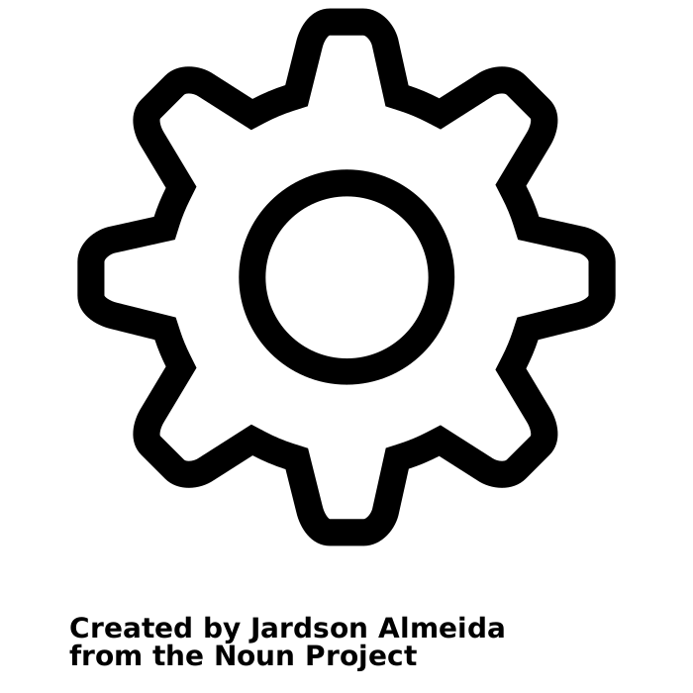


Barriers to research
Difficulty recruiting participants
Lack of standardized or readily available access to a means of identifying or recruiting research participants
Few or no strong relationships with community groups
Logistics/operational burdens
Labor intensive operations surrounding research activities like recruitment and scheduling
Managing contracts can be labor and time intensive
Inability to compensate participants
Many agencies can’t compensate public participants directly
Online user testing services often rely on professional testers and don’t represent the diversity of the public
Legal and policy interpretation issues
PRA processes are cumbersome, slow, and often misunderstood
Inconsistent guidance across agencies

Slide 18
Barriers to research: Recruitment
“The general consensus is that it (PRA process) remains burdensome and confusing for small-scale efforts when there’s a desire for quick turnaround.”
– A staffer at an executive branch agency

Slide 19
Barriers to research: Compensation
“We would love to give incentives but need to now rely on volunteers. This would increase participation immensely.”
– A staffer at a legislative branch agency
“The agency has an unclear appropriations authority to pay the public for this purpose. Attempts to get approved funding … have been killed in contracting or in legal.”
– A staffer at an executive branch agency

Slide 20
Barriers to research: Policy
“I think the biggest barrier with incentivized participation are the rules discouraging it... If there’s some policy/guidance that allows for it, it should be widely socialized among the UX community. If not, perhaps GSA can lead the way to develop that policy/guidance.”
– A staffer at an executive branch agency

Slide 21
Barriers to research: Operations
“…we’d need to figure out a method for procuring the gift cards and a process for distributing the gift cards. With budget season at its height, it didn’t seem like a good time to tackle this process.”
– A staffer at an executive branch agency

Slide 22



Consequences
Increase discrimination in systems (intentional or otherwise)
Potential to cause harm (mental or physical)
Inability to establish product/market fit

Slide 23
Successful Examples
Where efforts have been made toward solving this problem

Slide 24

GSA is focused on improving how we deliver services for the public
By building relationships with organizations serving socially marginalized communities and offering paid research opportunities for participants who face systemic barriers to equitable participation in usability testing, GSA can help drive how government services are created with the most underserved communities’ needs in mind.
From the GSA Equity Action Plan www.gsa.gov/equity

Slide 25
Overview of TTS’s compensation process
1
2
3
Document the need to compensate user research participants.
Submit a micro-purchase request for the total amount of compensation.
Complete the purchase on vendor gift card portal and distribute the gift cards.

Slide 26

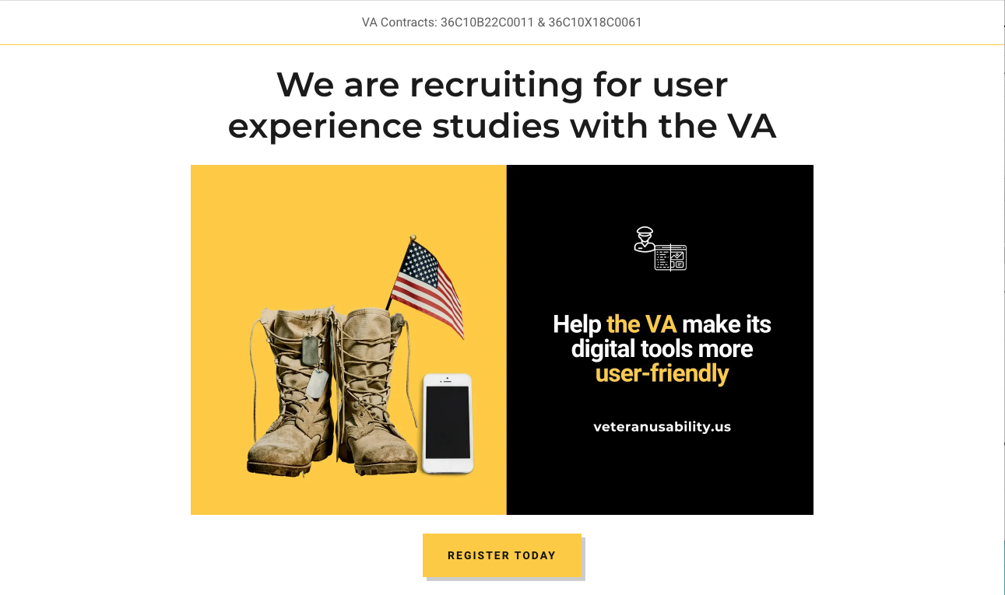
Research Ops in Government
Department of Veteran Affairs (VA) + United States Digital Service (USDS)
Has a research operations team that supports teams with:
Templates for studies and research plans
Standardized forms and processes
Manages contractual logistics for recruitment vendor
Contracted with a recruitment agency that:
Manages a database of participants
Identities representative individuals from database for specific research efforts
Handles participant compensation
Manages Privacy and De-identification to protect PII
Provides tooling for research and observation
veteranusability.us

Slide 27
Where else is this happening?
We’re interested in hearing from agencies that are connecting with the public to learn about their approaches and challenges.
Is your agency getting feedback from the public?
What approaches are working for you?
Have you seen other examples of supporting research with the public?
Can we talk?
Email us at:
matthew.dobson@gsa.gov
robert.jolly@gsa.gov

Slide 28
Enabling Government Research Operations
Our 10x project’s Phase 2 investigation

Slide 29
Phase 2 of our work is beginning
We’re kicking off Phase 2 of Enabling Government Research Operations.
Phase 1
Phase 2
Phase 3
Phase 4
Investigate
Discover
Develop
Scale
2-3 weeks
Understand the problem space
8-10 weeks
Understand the solution space
A few months
Build the solution
A lot of months
Scale the solution

Slide 30
Hypothesis
Solution: We believe that a shared research operations service will consolidate the logistical and operational efforts of research and provide agencies with the means to recruit and provide incentives to research participants in a more timely and efficient manner.

Slide 31
Hypothesis (cont’d)
Impact: This will empower agencies to focus on quality research—instead of operations—and will result in a greater quantity and diversity of people participating in research…and ultimately enable teams to deliver on the expectation of world-class customer experiences.

Slide 32
#WhatisResearchOps?
ResearchOps is a set of infrastructure services that support research efforts in organizations.
Research operations teams perform the necessary business, administrative, and logistical functions necessary to enable researchers to focus on preparing, conducting, and analyzing research activities.

Slide 33
#WhatisResearchOps? (cont’d)
A Federal Research Operations shared service could provide:
Procurement - contracting with recruiting companies
Recruitment (via shared database?) - Opportunity to identify and recruit participants across government boundaries –
Compensation for participants - standard rates and means of compensation
Scheduling - coordination of public and government teams
Policy interpretation related to issues of privacy and data retention

Slide 34
What’s next for Phase 2

Slide 35
Our top questions
High-risk questions to be answered in Phase 2
Legal/Policy
Procurement
Is there an approach or framework that can account for each agency’s interpretation of privacy laws, restrictions on compensating the public, security, privacy, and other issues?
Are there contracting vehicles that can work for GSA to enable access across agencies for providing these sorts of services?
Services
Ownership: Staffing and Sustainment
What wraparound or complimentary services would be necessary for the Research Operations team to provide beyond the contracting vehicle (e.g. consulting, training, conducting of research on behalf of the partner agencies)?
Where is the best long-term home for this service? How does that ownership impact the business model and potential customers? Where would funding come from, and does cost recoverability play a role?
This would require ongoing support and committed staff. What roles are needed?

Slide 36
We want to work with you
We’re interested in hearing from agencies about what you think and how this sort of service might support your work.
Questions, concerns, and risks?
Your agencies’ needs?
Where you are facing barriers to connecting with the public?
Any shared experience of similar efforts?
Email us at:
matthew.dobson@gsa.gov
robert.jolly@gsa.gov

Slide 37
Thank you
👋🏽

